Slide 1

Text Classification on News Articles
By…
Madhu (mb4236)
Spandana (sb4262)
Vuthej Krishna (vv334)

Slide 2
Overview
Goal
Dataset Source and Overview
Data Cleaning and Pre-processing
Baseline Model
Methodologies Utilized / Experiments done
Metric Evaluation
Issues Faced
Future Scope

Slide 3

Objective
Text Classification allows us to easily search for a specific content through search engines and carter information to targeted groups.
To implement Bidirectional Encoder Representations from Transformers for classifying news articles.

Slide 4
Dataset Source
AG’s corpus of news articles. - http://groups.di.unipi.it/~gulli/AG_corpus_of_news_articles.html
https://github.com/mhjabreel/CharCnn_Keras/tree/master/data/ag_news_csv
Available in 3 formats
DB Version
XML Version
CSV Version

Slide 5
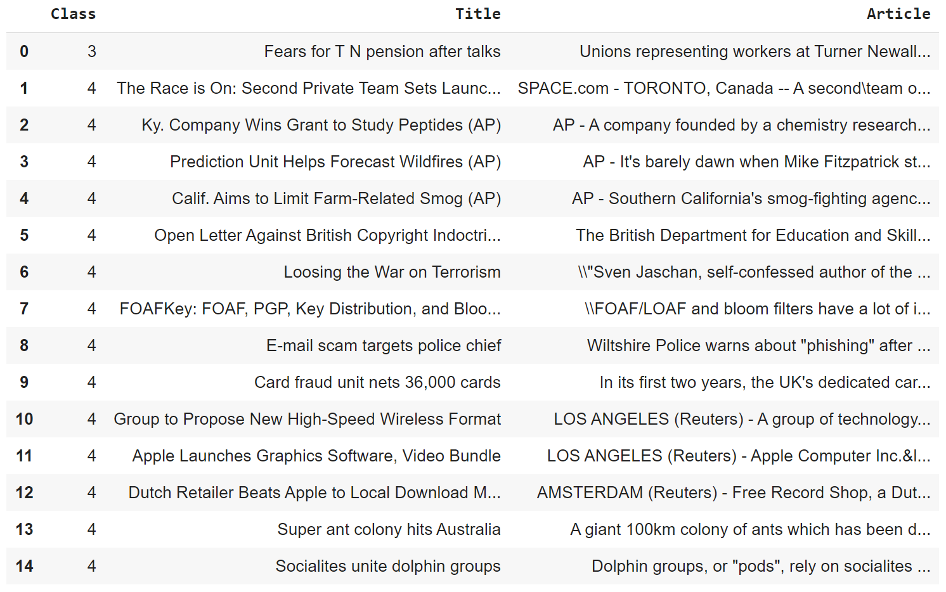
Data Overview
CSV Format Data
Target Class
World
Sports
Business
Sci/Tech
Train Data – 30,000 samples for each class of articles.
Test Data – 1900 samples for each class of articles.

Slide 6
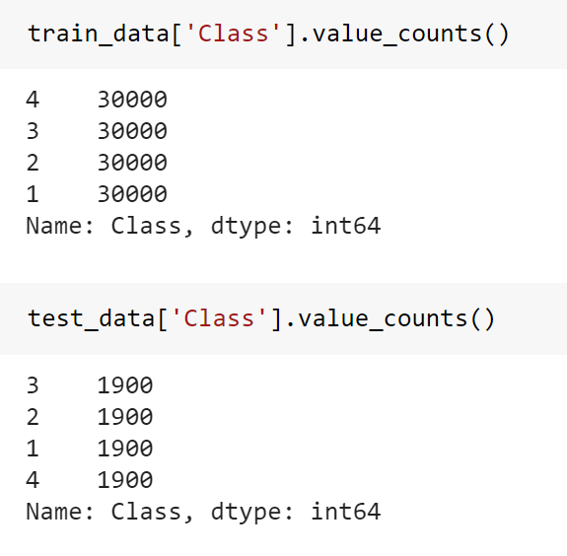
Perfectly Balanced Data

Slide 7
Pre-processing of Data
Articles included special characters.
Removal of delimiters and extra spaces.
Converting target classes into numerical categorical values.
World as 0
Sports as 1
Business as 2
Sci/Tech as 3
Categorical values from 0 instead of starting from in order to resolve CUDA runtime errors. - (Incompatible if started target class variable started off from 1)
Tokenization & Word Embeddings

Slide 8
Baseline Model
Sequential Neural Network
Keras.layers.embeddings
Sigmoid as Activation function
Adam as optimizer
Categorical_crossentropy as the Loss function

Slide 9
Implemented Methodologies
BERT with
Keras embedding
BERT embedding
ELMo embedding

Slide 10
Metric Evaluation
Approach-1 Accuracy : 24%
Approach-2 Accuracy : 25%
Approach-3 Accuracy : 88%

Slide 11
Challenges Faced
ELMo Embeddings – Unsuccessful Attempt
Time consuming to process the model on the complete dataset.
Classification of news articles into Sports and Sci/Tech was easier relative to World and Business Classes.

Slide 12
Application this fits into..
Auto tagging of customer reviews – All e-commerce systems which has numerous user reviews.
Helpful in building Chat-bot

Slide 13
Future Work
Implementing successfully with ELMo
Models can be further enhanced by hyper-parameter tuning
Can be extended for larger dataset

Slide 14
Thank You!

